Slide 1
Are Humans Inherently Good or Evil?
Through the study of virtual simulations and games

Slide 2
Ethics, Morals & Empathy
Ethics:
Set of personal/private standards
Morals:
A more universal set of guidelines
Empathy is key to defining a player’s ethics
The way a player relates to others affects behaviour
Notes:
In their shoes

Slide 3
General Player Behaviour
Experimental studies have shown that violent video games:
Increase aggressive behaviours
Increase hostile expectations for others’ behaviours
Decrease helping behaviour

Slide 4
Cognitive Process
Aggression impacts player cognitive processes
Many factors affect the level of aggression
Aggression level is key to player behaviour which in turn affects ethical decision

Slide 5
Controlling Player Behaviour
Factors that affect player behaviour:
Level of exposure to violence
Solo, Cooperative, or Competitive environments
Frustration
Rewards or Punishments
Communication Channels
Social Identity
Group Interaction
Gender
Notes:
Should explain each one throughout the presentation

Slide 6
Study: Automatic Aggressiveness from DOOM and Mah-jongg
Test group played Doom and Mah-jongg
Equal play intervals (10 minutes)
Completed an Implicit Association Test (IAT)
Participants categorize words under 4 headings:
Self and Other
Aggressive and Peaceful
The more positive the score, the stronger aggression and self were associated
Notes:
121 participants (SOLO Game)

Slide 7
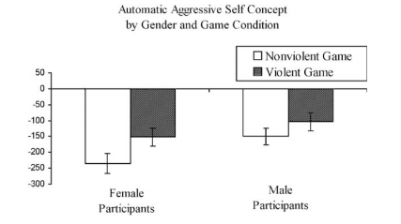

Slide 8
Results
SURPRISE: Playing violent video games can increase aggressiveness
Aggression level raised, but still not high
What if players were in the presence of others?

Slide 9
Cooperative and Competitive Play
Many studies simplify game characteristics as violent and non-violent
Aggression is affected by more than just exposure to violence:
Availability of humans (friend or foe)
Rewards
Play mode

Slide 10
Competition and Aggressive Cognition
Reward structures in competitive modes alter cognition (i.e. killing for points)
Presence of competition can serve as a motivator and produce enjoyment
Competition can also lead to frustration
Players impede success of one another
Notes:
Competition by nature makes players impede success of one another (even if its simply by beating them without actually interfering with them)

Slide 11
General Aggression Model (GAM)
Model for aggression
Factors in that learning may be a mechanism for aggression
Individuals mimic actions
Behaviours learned when rewarded or punished even if self-administered
WarZ player behaviour can be attributed to learning mechanisms
Notes:
Players get killed repeatedly, so why try to be friendly when it only ever results in frustration, better than other models because it accounts for learning as a mechanism of aggression

Slide 12
Cooperation and Aggression
In 2007, Eastin conducted a study of human players:
Different group sizes (2,4,6)
Different goals (fight with or against each other)
Communication through voice-chat
Results demonstrated that:
Larger groups were more aggressive
Aggression was higher when competing rather than cooperating
Notes:
Aggression can be attributed to arousal level, which would explain why players would gravitate to aggressive actions in a game

Slide 13
Study: Aggression and Play Mode in HALO
Competitively and Cooperatively (30 minutes)
Participants filled out questionnaire:
Complete words (KI, DE, BL, ST, RI, SL)
Determined aggressive cognition
Arousal level (excitement/anxiousness) and Aggressive Affect (anger) were also monitored

Slide 14
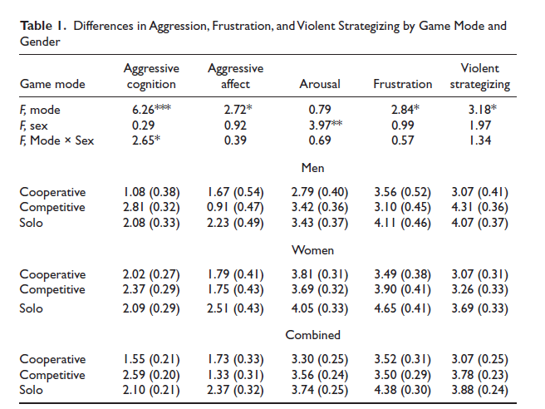

Slide 15
Results
Competitive players showed the highest level of cognitive violence
Solo players were most angry and frustrated
Cooperative was the lowest in terms of violent strategizing
Possible reasons: survival (competitive and solo)
Notes:
Solo players and competitive players have a more real threat than cooperative players (no humans against, but humans playing with safer), solo players who die a lot will have increased frustration much like competitive players which increases aggression

Slide 16
Hostile Expectations
Game environments can promote hostile expectations:
Players in a state of greater hostility assume hostile intentions of others (i.e. WarZ)
Research on hostile expectations expands the GAM to include group dynamics
How does social interaction affect behaviour?
Notes:
So far aggressiveness and ethics have been associated with in game actions, but what about social interaction with other players (how does that determine behaviour)

Slide 17
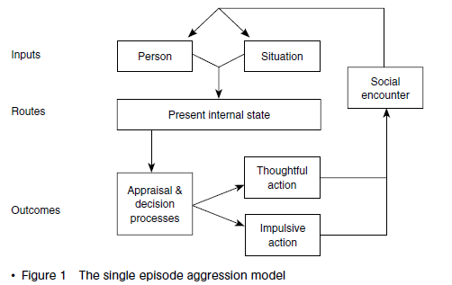
Interaction with Players
Notes:
Situation includes the game content / conditions and the person includes player’s gender/traits

Slide 18
Social Interaction
Williams and Skoric suggest no long-term effects from violent gameplay (exposure)
Asheron’s Call 2
Designated zones for combat
Players frequently help weaker players or less knowledgeable players
Counter-example:
WarZ
Designated zones for non-combat
Players frequently try to kill other players regardless of player knowledge
Notes:
Hostile expectations in WarZ affect the cognitive decision process of players, OPEN WORLD vs. CONTROLLED WORLD (constraints placed on play)

Slide 19
GAM Inputs for Aggressive Cognition
Trait Hostility
Cognitive structure that exaggerates indications of hostility
Game Experience
Time spent playing violent video games (hostile response)
Group Size
Large groups are more competitive than small groups
Notes:
Gamers score lower on empathy scores

Slide 20
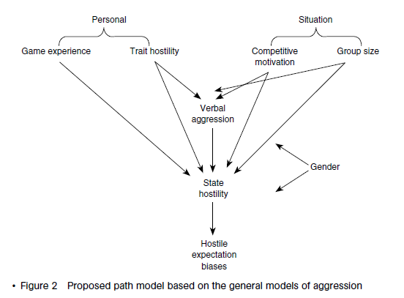

Slide 21
GAM Inputs – Verbal Aggression
In-Game Verbal Aggression
Aggressive communication directly connects aggressive behaviour (i.e. insults, profanity, ridicule)
Results of a story completion protocol test:
verbal aggression raises hostile expectation bias
Greater anonymity results in greater tension and antagonism (no social standing)
Notes:
Better communication channels such as voice chat allow groups to work together more effectively (allowing them to become more aggressive) as well as antagonize other players more naturally, increasing aggression

Slide 22
Griefing and Grief Play
Griefing
Disruptive cultural activity (i.e. hacking, crashing economies, servers, stealing characters, etc.)
Grief Play
Using the boundaries of the game world to disrupt other player’s gaming experiences
But why do these things to begin with?
Notes:
While on the subject of antagonism and lack of social standing, we should also look into Griefing (almost a form of being evil, why behave in such a manner).

Slide 23
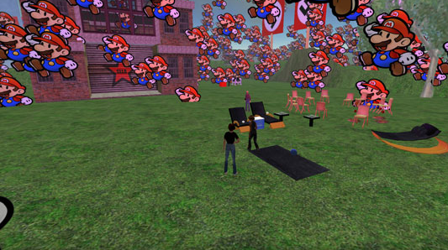
Study: Griefing Second Life

Slide 24
Study: Griefing Second Life
Second Life
Considered a platform rather than a game
Main purpose is player interaction
Griefing is a cultural phenomenon rather than just play in SL
Collective goal is to bring down the system

Slide 25
Study: Griefing Second Life
Griefing brings together users with similar goals (to the detriment of others)
Organized griefing becomes a culture, not just isolated pathology (PN group from /i/ on 4chan)
Similar to cooperative or competitive play in groups
Demonstration of power through knowledge (i.e. scripting)
Notes:
Give example of griefing residents with alternate lifestyles

Slide 26
Study: Griefing Second Life
SL has a list of forbidden behaviour (a moral code per se):
Intolerance, Harassment, Assault, Disclosure, Indecency and Disturbing the Peace
Ethical codes are specific to each subculture or group
Griefers have their own subculture
Moral code is only a moral code if it can be enforced (ex. Bans)
Good and Evil are determined by each subculture’s ethics (subjective) and the game’s moral code

Slide 27
Deindividuation Theory
When individuals assimilate with a crowd, their consideration for consequences of actions is diminished (anonymity)
Video Games lack social cues and social standards – open communication
Anonymity does not result in a loss of awareness but a shift
Personal to social
Notes:
We look at deindividuation theory to see how groups behave, multiplayer games result in people behaving in a way that satisfies the groups intentions and ethics

Slide 28
Ethical Choices in Solo Play
Ethical thinking
Ability to assess, interpret and reflect on decisions
Empathize with others
Comprehend complexities of ethical questions
Problems with examining ethical choices in video games:
No real-world risks (can choose again)
Morality meters

Slide 29
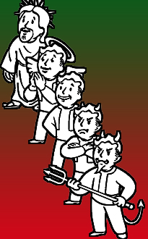
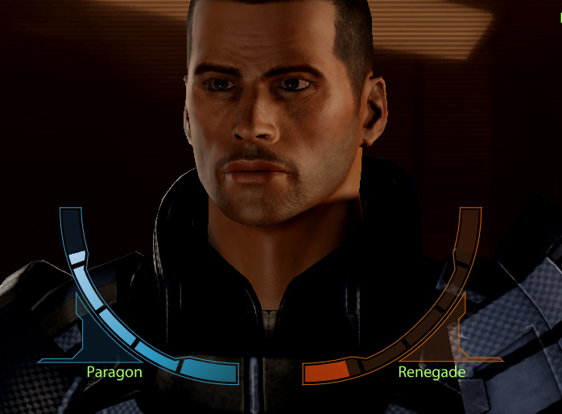
Morality Meters
Notes:
Encourage maximization of “good” or “evil”, almost like any other attribute.

Slide 30
Study: Ethical Choices in Fable 3
Test group documented how they handled certain scenarios in-game:
“Surrender a Friend”
“Walter”
“Build a brothel”

Slide 31
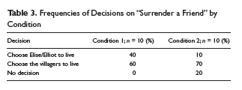
Study: Ethical Choices in Fable 3

Slide 32
Results
Based on the “Surrender a Friend” scenario:
Impulse decisions are generally self-less decisions
Planned decisions are generally selfish
The other 2 scenarios follow these results as well
Gender of the avatar effected decisions as well
If the player could not empathize with one choice, the other was made

Slide 33
Conclusion
Are humans inherently good or evil?
Neither
Humans have the instinct to survive
Cognitive aggression is born from the desire to succeed
Belonging is an important subconscious desire that offers safety and promotes aggression for the success of the group
Good and evil completely depend on the culture examining or the individual involved
Examining multiplayer interaction is far more significant than solo play, it offers a closer connection to reality

